Slide 1
Hemodynamic Fluent Calculation Guide
By: Asad Mirza
For: CV-PEUTICS

Slide 2
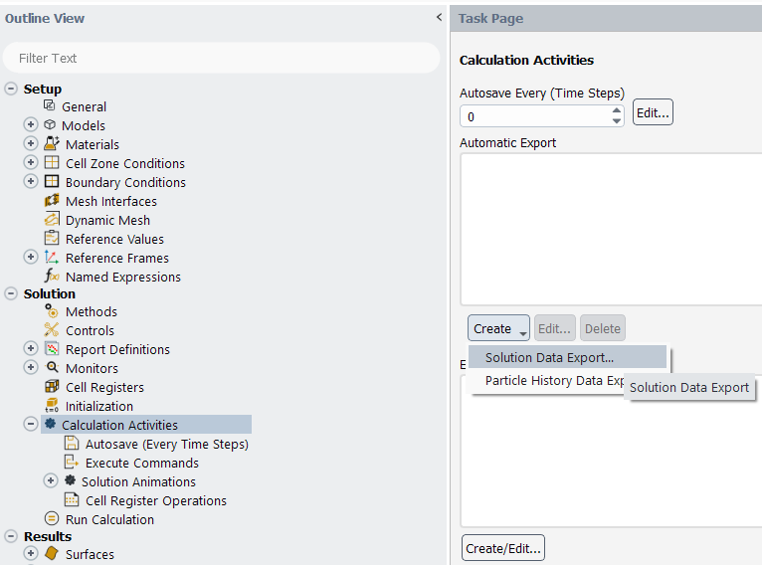
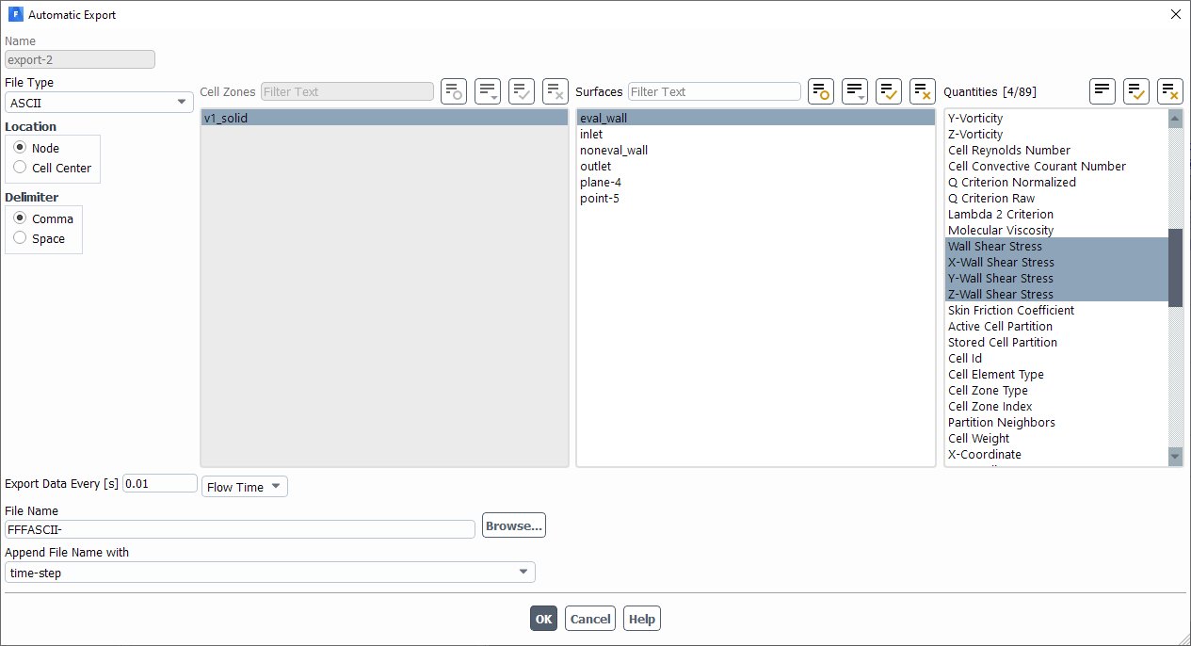
Setting Up Fluent Export
Calculation Activities → Create → Solution Data Export
File Type: ASCII
Location: Node
Delimiter: Comma
Surface: Surface whose OSI/TAWSS you’re interested in
Quantities: Wall Shear Stress and XYZ Wall Shear Stress

Slide 3
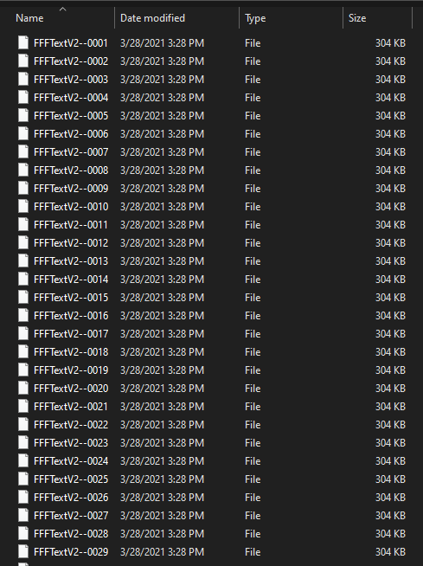
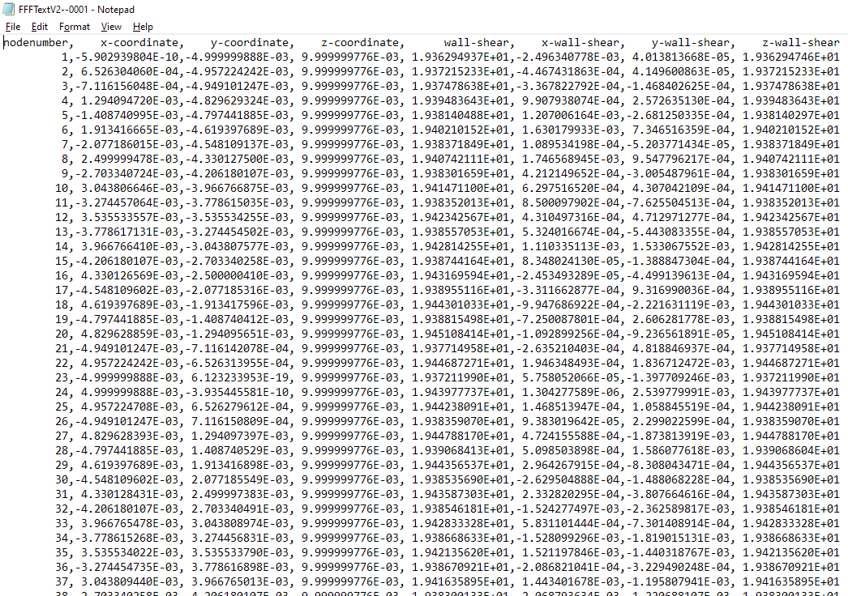
Exported Data

Slide 4
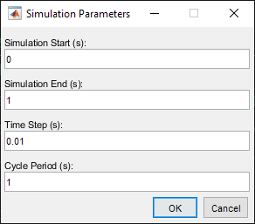
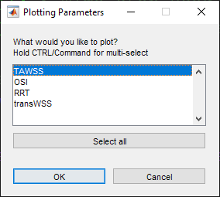
Post-Processing: Setting Parameters
The MATLAB script titled “Fluent_Post_Processing.m” must be run to process the exported data.
It will ask you for the following:
Simulation Start Time
Simulation End Time
Time Step Size
Cycle Period
You will then be asked which results you wish to plot: TAWSS, OSI, RRT, or transWSS

Slide 5
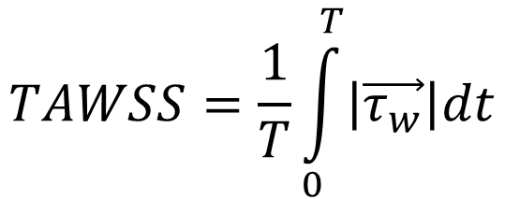
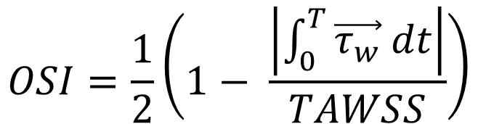
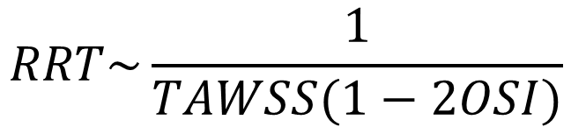
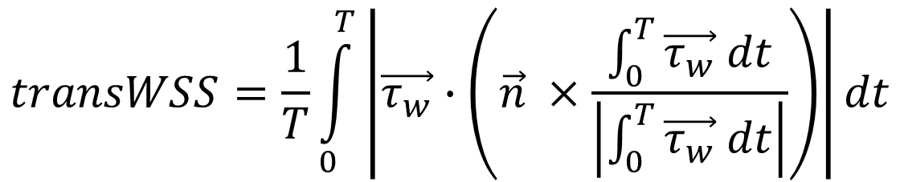
Post-Processing: TAWSS/OSI/RRT/transWSS
$$TAWSS=\frac{1}{T}\int_{0}^{T}{\left|\vec{τ_{w}}\right|dt}$$
$$OSI=\frac{1}{2}\left(1− \frac{\left|\int_{0}^{T}{\vec{τ_{w}} dt}\right|}{TAWSS}\right)$$
Measures average of the degree of forward/backward fluid movement over time.
Measures average WSS on a surface over time.
$$transWSS=\frac{1}{T}\int_{0}^{T}{\left|\vec{τ_{w}}∙\left(\vec{n} ×\frac{\int_{0}^{T}{\vec{τ_{w}} dt}}{\left|\int_{0}^{T}{\vec{τ_{w}} dt}\right|}\right)\right|dt}$$
$$RRT\sim \frac{1}{TAWSS(1−2OSI)}$$
Measures a fluid particle’s relative time spent in a particular location on fluid surface over time.
Measures multidirectional WSS on a surface over time.

Slide 6
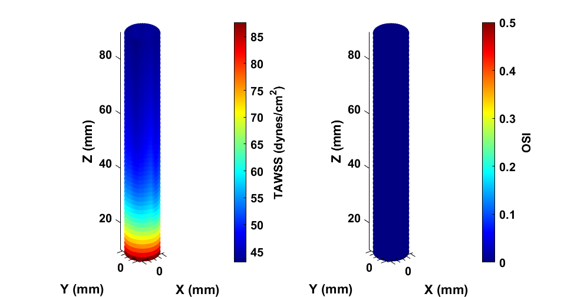
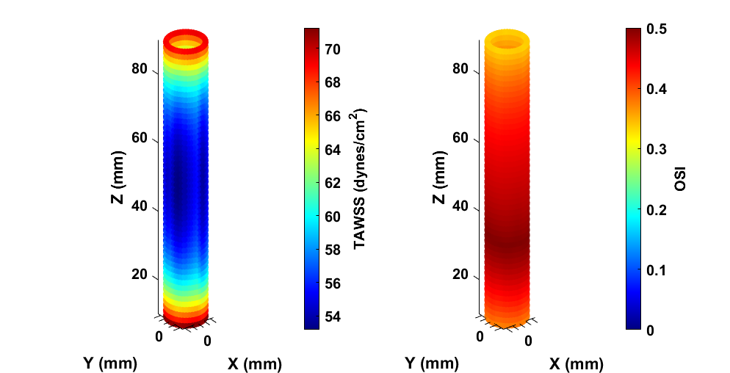
Post-Processing: TAWSS/OSI Plotting
Ex: +1 m/s Inlet
Ex: +/- 1 m/s Inlet

Slide 7
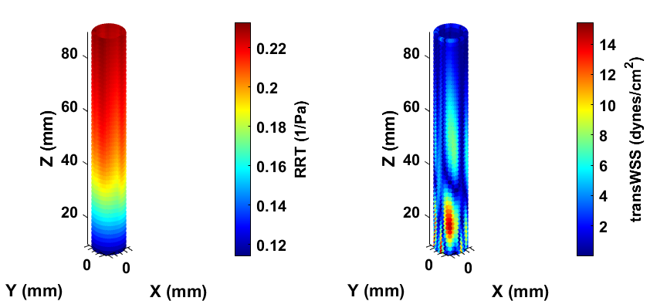
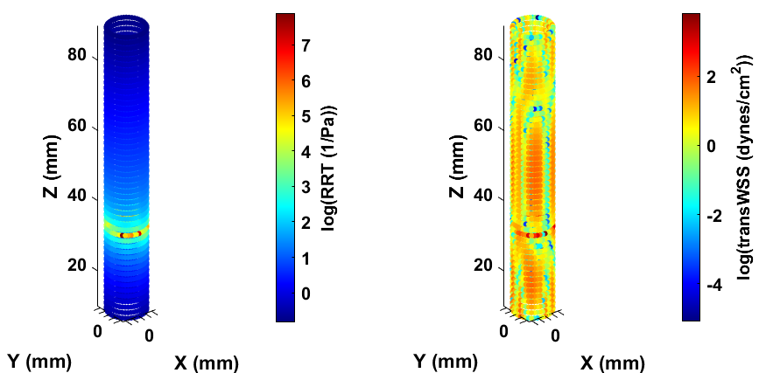
Post-Processing: RRT/transWSS
Ex: +1 m/s Inlet
Ex: +/- 1 m/s Inlet

Slide 8
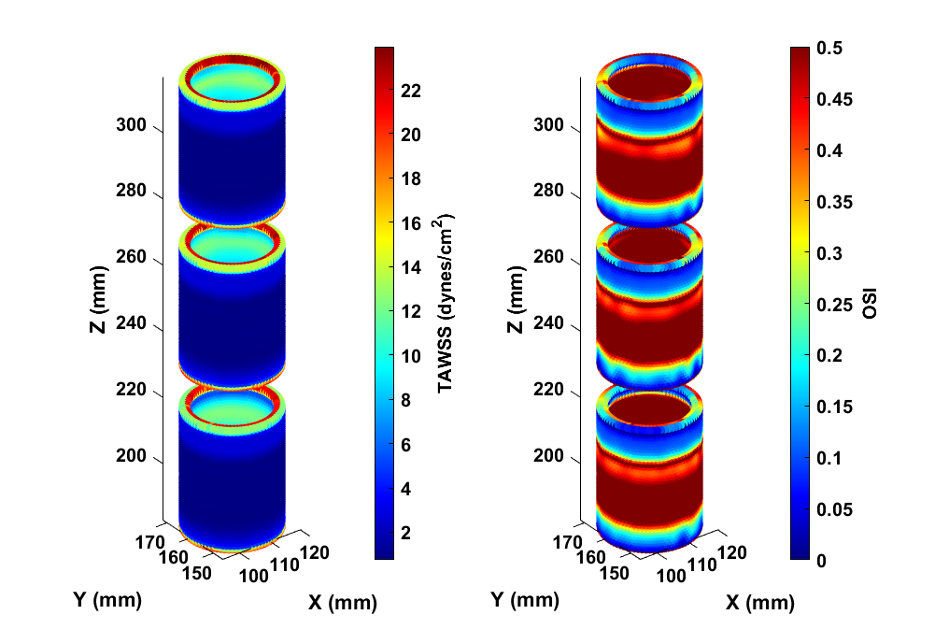
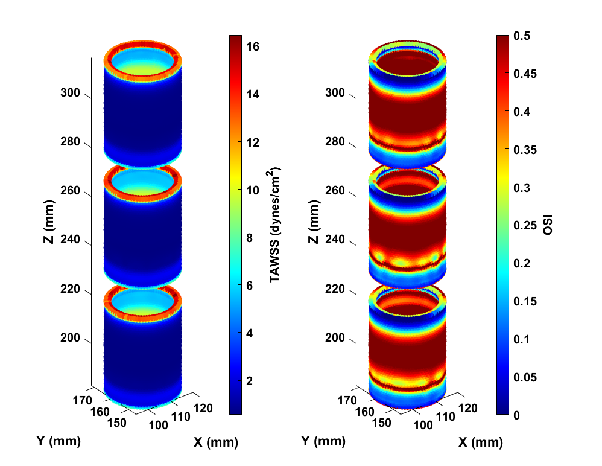
Post-Processing: More Examples (TAWSS/OSI)
Ex: S35/4 Waveform
Ex: Inlet Squared by 4 Waveform

Slide 9
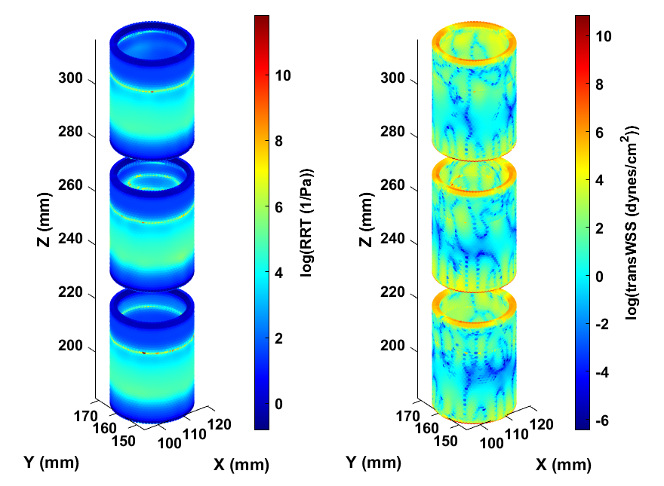
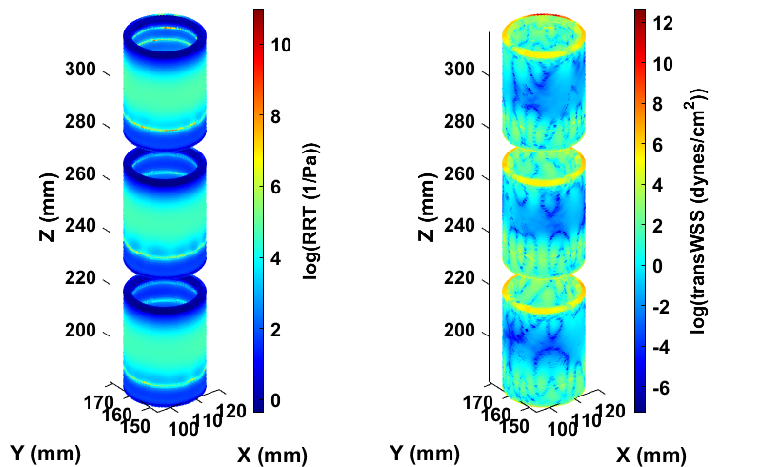
Post-Processing: More Examples (RRT/transWSS)
Ex: S35/4 Waveform
Ex: Inlet Squared by 4 Waveform

Slide 10
Future Improvements
Proper surface/element plotting rather than point cloud
Faster processing of many points
Reporting of Average +/- Standard Deviation for the exported surface
Creation of interactive GUI to simplify data processing.
Export GUI as exe to allow function outside of MATLAB

Slide 11
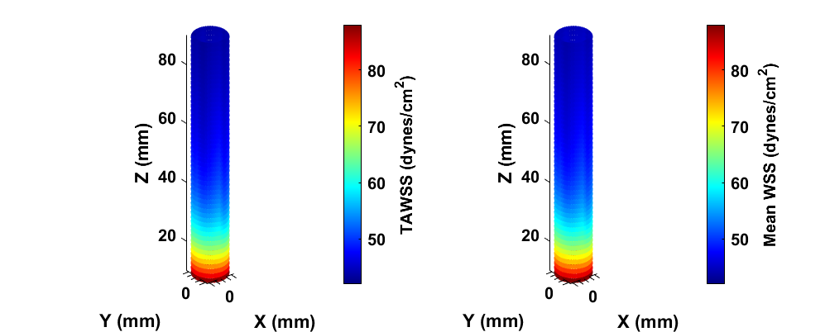
Comparing MATLAB TAWSS with Fluent Mean WSS
MATLAB
Fluent
Error = 1.305%

